Slide 1
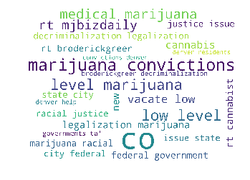
Colorado Marijuana Project
David Martinez
Regis University, MSDS696 Data Science Practicum II
December 2018
What Denver is saying about Marijuana on twitter, 12/13/2018, ~11PM
Notes:
The Word Cloud was generated using python 3.x

Slide 2

Discussion Points
Purpose
History of Cannabis in CO
Sales
Taxation
Denver Crime
Sentiment Analysis
Conclusions & Further Study
Links

Slide 3
Purpose of Project
Colorado is one of ten states that have legalized marijuana for recreation use and one of 32 states to allow marijuana for medicinal purposes. In Colorado, marijuana has become a billion dollar a year business generating hundreds of millions of dollars in tax revenue. Additionally, as all marijuana growth, cultivation, packaging, transportation, and sales occur within Colorado, all business expenses are generated locally, and all profits are kept in the state.
Goal: This is an ongoing study of the impact of Marijuana on Colorado in revenue, taxation, and crime.
As Denver is the most populated city (705K in 2017) and accounts for the highest medical (49% or 202M) and recreational marijuana sales (34% or 375M), it will be used to examine the impact of cannabis on crime.

Slide 4
Colorado Cannabis History
March 2017 – Cannabis Prohibition Begins
November 2000 – Amendment 20 (Medical Marijuana) passes with 54% approval allowing adults 18+ to be prescribed medical marijuana by a licensed physician
November 2012 – Amendment 64 (Retail Marijuana) passes allowing adults 21+ to purchase marijuana for recreational purposes
*Federal law still classifies Marijuana as a Schedule I drug along with heroin, bath salts, and LSD
January 2014 – Retail Cannabis Sales begin - effectively ending the period of prohibition statewide although each municipality still determines its local legality and taxes
*April 2017 – 96 of 272 (36%) of Colorado Municipalities allow recreational Marijuana sales

Slide 5
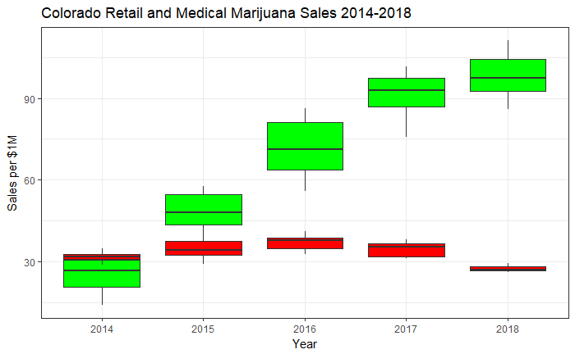
Colorado Marijuana Sales* Retail sales are increasing year over year Medical sales are generally flat but appear to be on the decline *2018 sales represent sales to date as of August, 2018

Slide 6
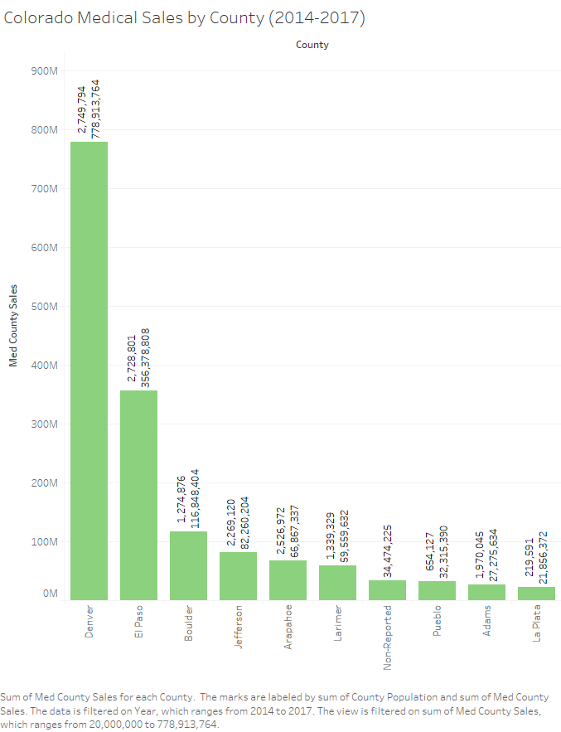
Denver, El Paso (Colorado Springs), and Boulder counties represent ~30% of the states population and ~79% of medical marijuana sales: 2017: CO Med Cannabis sales: $416,516,818 Denver, El Paso, and Boulder sales: $327,464,527 CO Population: 5,609,421 Denver, El Paso, and Boulder counties population: 1,729,788 Denver: 12.6% population, 48.7% sales El Paso: 12.5% population, 24.5% sales Boulder: 5.7% population, 5.3% sales

Slide 7
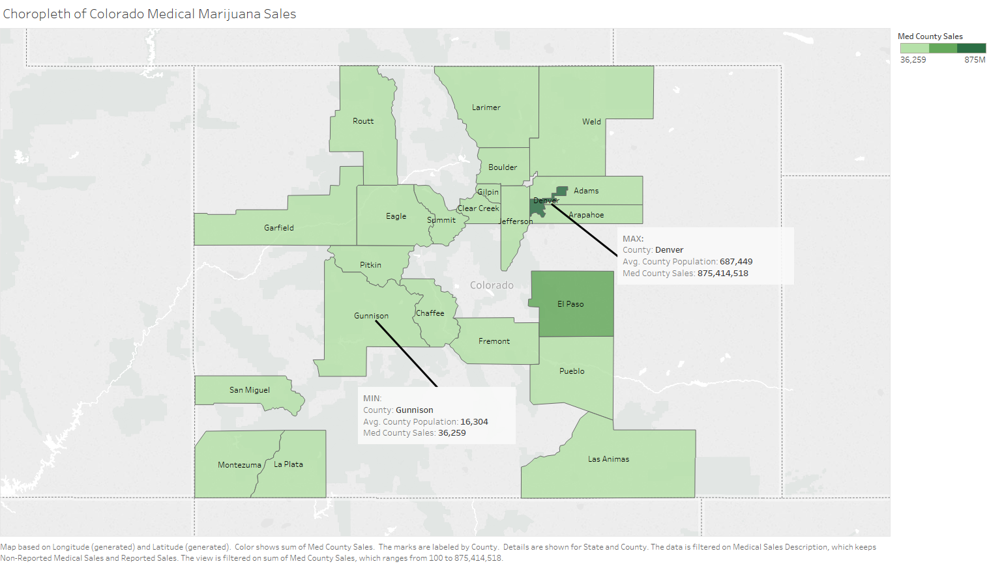

Slide 8
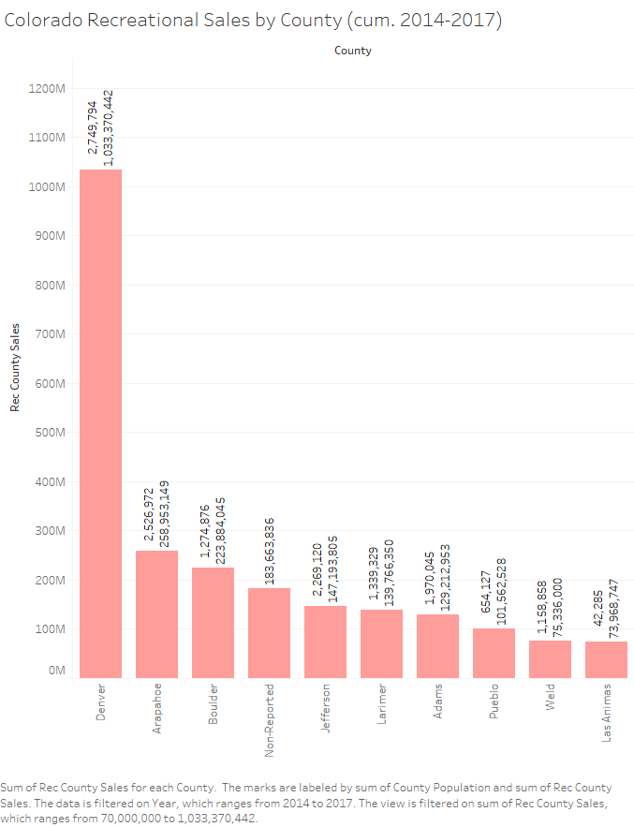
Denver, Arapahoe, and Boulder counties represent ~40% of the states population and ~52% of recreational marijuana sales: 2017: CO Rec Cannabis sales: $1,089,778,095 Denver, Arapahoe, and Boulder sales: $563,948,132 CO Population: 5,609,421 Denver, Arapahoe, and Boulder counties population: 1,671,762 Denver: 12.6% population, 34% sales Arapahoe: 11.4% population, 10% sales Boulder: 5.7% population, 7% sales

Slide 9
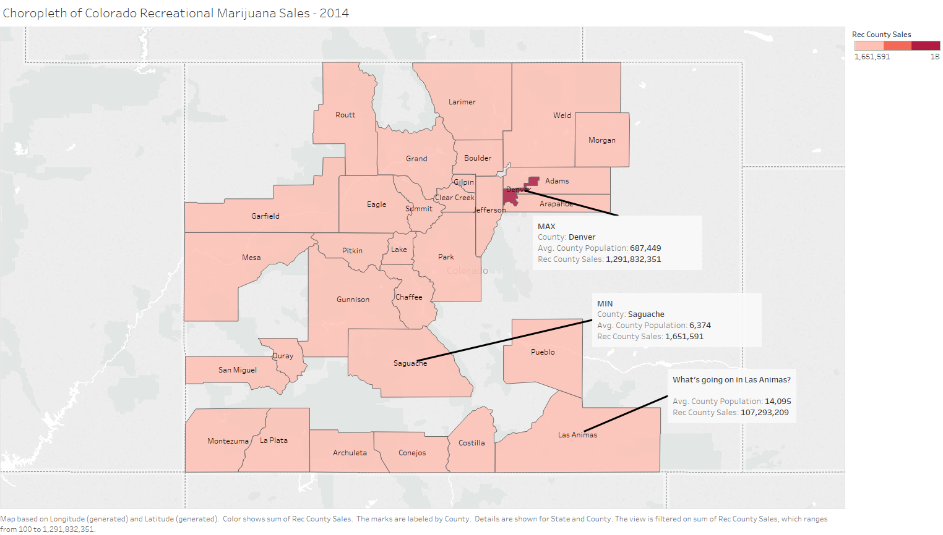

Slide 10
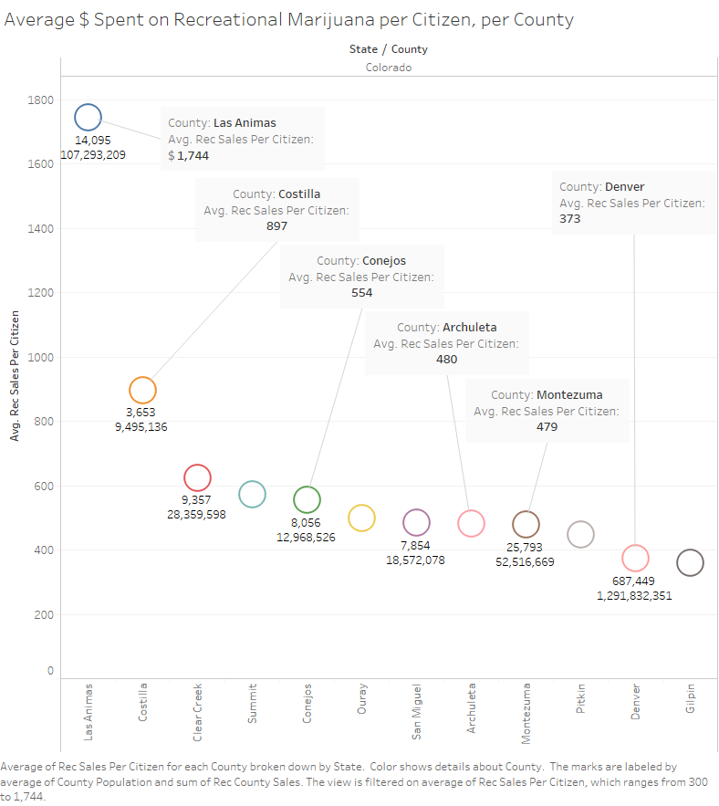
The Curious Case of Las Animas… Las Animas stands out for having a low county population (14K) compared to high recreational marijuana sales (107M) At issue is that the average cost of marijuana per county citizen is 4X+ the cost of marijuana in Denver Las Animas* provides easy access to Kansas, Oklahoma, Texas, and New Mexico to recreational marijuana – the higher sales may be from out-of-staters visiting for the day *Costilla, Conejos, Archuleta, and Montezuma counties also provide easy access to New Mexico

Slide 11
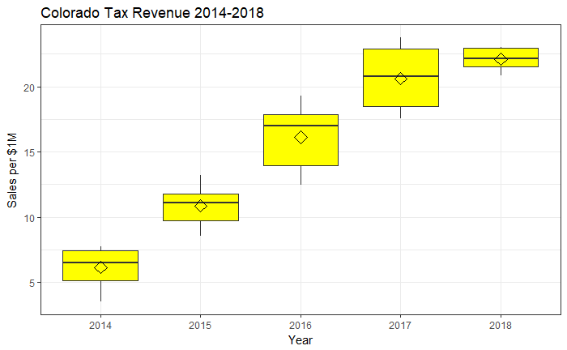
Colorado Tax Revenue

Slide 12
Colorado Marijuana Taxation
Medical Marijuana (3+%)
Recreational Marijuana (30+%)
State Retail Excise Tax (included in sales price): exempt
State Sales Tax: 2.9%
State Retail Marijuana Sales Tax: exempt
Local and Special Districts Tax Rates: varies by Municipality/District
State Retail Excise Tax: 15%
State Sales Tax: exempt as of July 1, 2017
State Retail Marijuana Sales Tax: 15% as of July 1, 2017
Local and Special Districts Tax Rates: varies by Municipality/District
Source: https://www.colorado.gov/pacific/tax/marijuana-taxes-file

Slide 13
Where do the taxes go?
Recreational Marijuana Sales
Excise Tax (15%)
<=40M
Public School Capital Construction Fund (<=40M)
>40M
Public School Fund (>40M)
Municipal Tax (variable)
ALL
Local Govt. Appropriations
15%
Marijuana Tax Cash Fund
Special Marijuana Sales Tax (15%)
85%
Medical Marijuana Sales
State Sales Tax (2.9%)
State Govt. Appropriations
ALL
Source: http://leg.colorado.gov/sites/default/files/fy17-18apprept.pdf

Slide 14
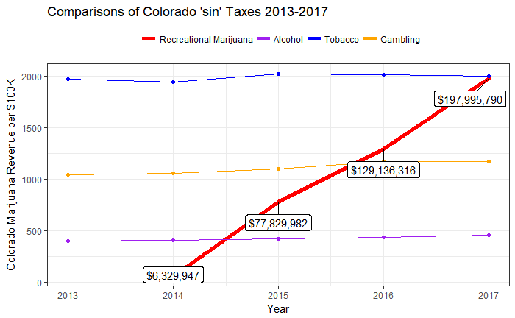
Marijuana state revenue as compared to other Colorado behavior revenue sources
Taxes from recreational marijuana sales exceeded taxes collected for
Alcohol: 2015
Gambling: 2016
Tobacco: on track to surpass in 2018

Slide 15
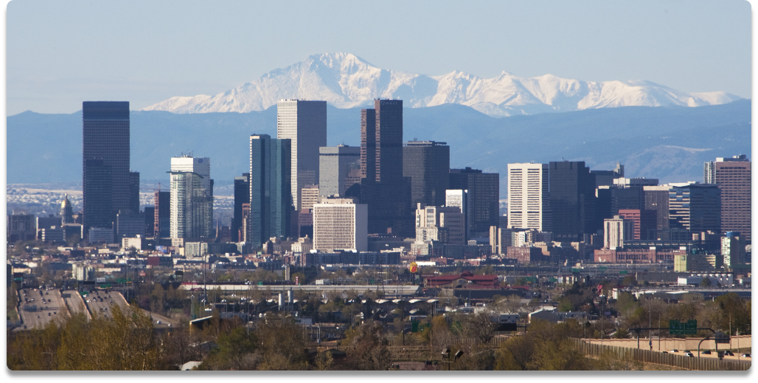
Denver Crime

Slide 16
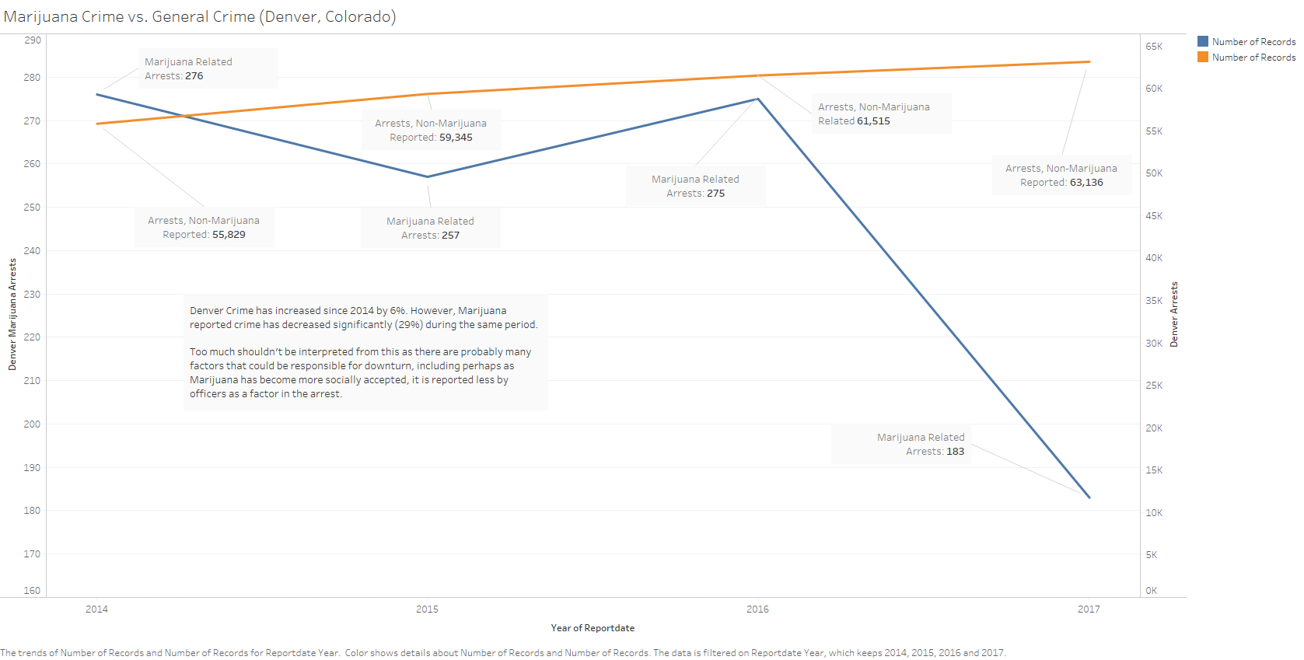

Slide 17
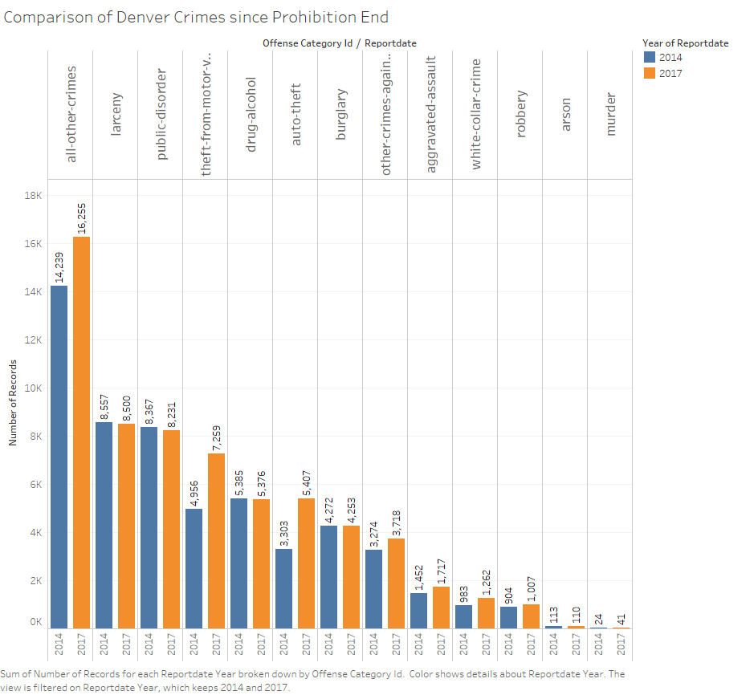

Slide 18
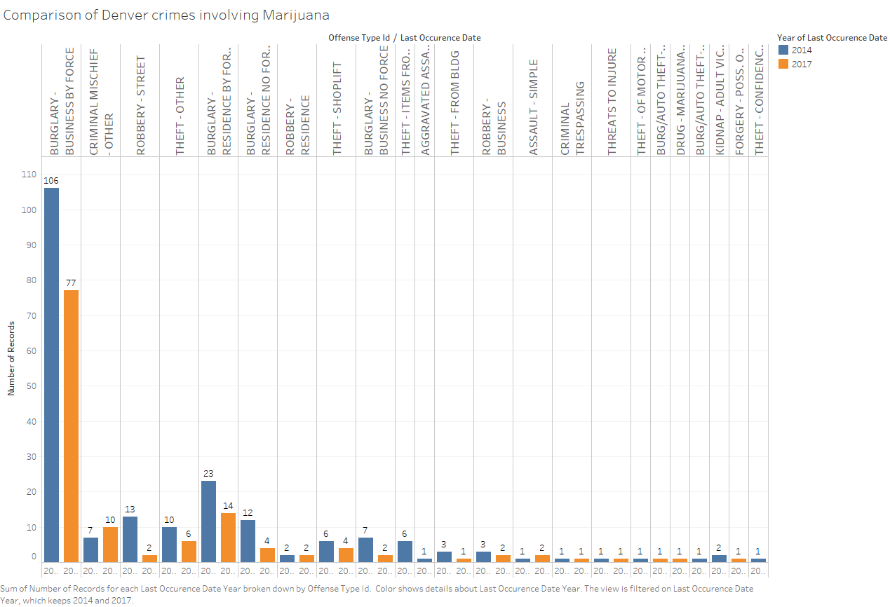

Slide 19
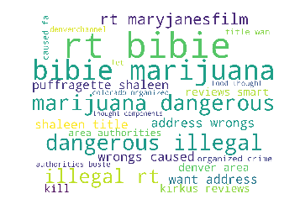
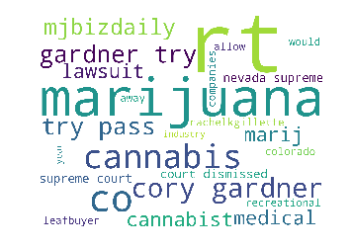
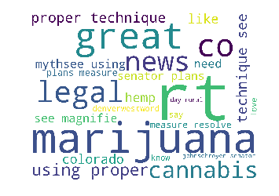
Colorado Public Opinion
What Denver twitter users were saying about marijuana on 12/15/2018:
Negative
All Tweets
Positive

Slide 20
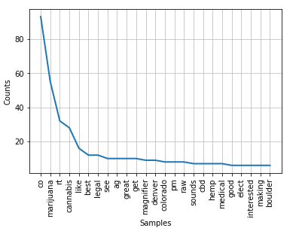
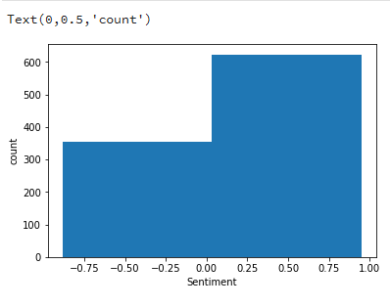
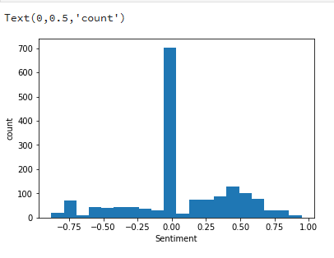
Sentiment Analysis
Twitter Sentiment Analysis was performed on 1,664 tweets from the Denver city center (+15 miles) for the topic of Marijuana on Dec 15, 2018
Most of the tweets were neutral (lower chart) but when neutrality was removed, tweet sentiment was generally favorable (upper chart) towards Marijuana

Slide 21
Conclusions and Next Steps
Too little longitudinal data exists to make any certain conclusions

Slide 22
Links & Citations
Github landing page: https://github.com/davelovesdata/Colorado-Marijuana-Project
Includes this presentation, supporting R, Python, and Tableau packages, and datasets
Boulder Crime Statistics: https://bouldercolorado.gov/police/crime-statistics
Denver Marijuana Licenses: https://www.denvergov.org/opendata/dataset/city-and-county-of-denver-marijuana-active-business-licenses
Denver Marijuana Sales: https://www.denvergov.org/opendata/dataset/city-and-county-of-denver-marijuana-gross-sales
Denver Marijuana Sales Tax: https://www.denvergov.org/opendata/dataset/city-and-county-of-denver-marijuana-sales-tax

Slide 23
Links & Citations
Denver Marijuana Crime: https://www.denvergov.org/opendata/dataset/city-and-county-of-denver-crime-marijuana
Denver Crime: https://www.denvergov.org/opendata/dataset/city-and-county-of-denver-crime
Colorado County Marijuana Sales: https://www.colorado.gov/pacific/revenue/colorado-marijuana-sales-reports
Colorado County Tax Collections: https://www.colorado.gov/pacific/revenue/colorado-marijuana-tax-data

Slide 24
Links & Citations
Joint Budget Committee Appropriations Report, 2017-2018: http://leg.colorado.gov/sites/default/files/fy17-18apprept.pdf
Population data: https://demography.dola.colorado.gov/

